Slide 1
Networked Data Lab Interim Analysis
Mental Health Prescribing

Slide 2


NDL Overview
5 partner sites around Great Britain
Shared problems
Phase 2 (2021): Children & Young People

Slide 3

Aberdeen/Grampian
Understand who is seeking help
Describe and quantify inequalities
Crisis Outcomes
Interim Analysis:
MH Prescribing

Slide 4
Mental Health Prescriptions
From Scotland’s Prescribing Information System (PIS) dataset
All prescriptions filled in the community (i.e. outside hospitals)
For all of Grampian
Jan 2012 – May 2021
Aged 0 – 24
Subset of BNF Chapter 4 medications
Hypnotics & Anxiolytics
Drugs used in psychoses and related disorders
Antidepressant drugs
CNS Stimulants and drugs used for ADHD
Drugs used in substance dependence

Slide 5
Who receives MH Prescriptions?
Year | Prescriptions | Individuals | Individual Rate | Population Estimate | Population Rate | Prescriptions per month
2012 | 41,093 | 7,884 | 5.2 | 167,271 | 0.2 | 3,424
2013 | 45,854 | 8,335 | 5.5 | 167,830 | 0.3 | 3,821
2014 | 52,330 | 9,039 | 5.8 | 168,034 | 0.3 | 4,361
2015 | 60,598 | 9,984 | 6.1 | 167,630 | 0.4 | 5,050
2016 | 66,739 | 10,391 | 6.4 | 165,507 | 0.4 | 5,562
2017 | 70,861 | 10,489 | 6.8 | 162,513 | 0.4 | 5,905
2018 | 73,267 | 10,278 | 7.1 | 160,341 | 0.5 | 6,106
2019 | 68,423 | 10,222 | 6.7 | 159,572 | 0.4 | 5,702
2020 | 65,119 | 9,359 | 7 | 158,282 | 0.4 | 5,427
2021* | 35,122 | 7,977 | 4.4 | * | * | 7,024
* Data for 2021 is incomplete and there are no published population estimates for this year.

Slide 6
Patterns by Age Group
Age Group | Prescriptions | %
Pre-School & Lower Primary | 27,111 | 5%
Upper Primary | 73,144 | 13%
Lower Secondary | 80,368 | 14%
Upper Secondary | 81,442 | 14%
School Leavers | 317,341 | 55%
Total | 579,406 | 100%
0 - 7
8 - 11
12 - 15
16 - 18
19 - 24

Slide 7
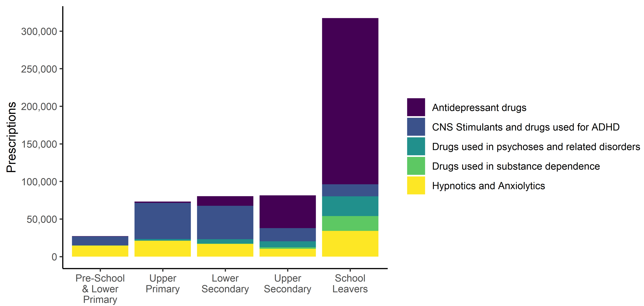
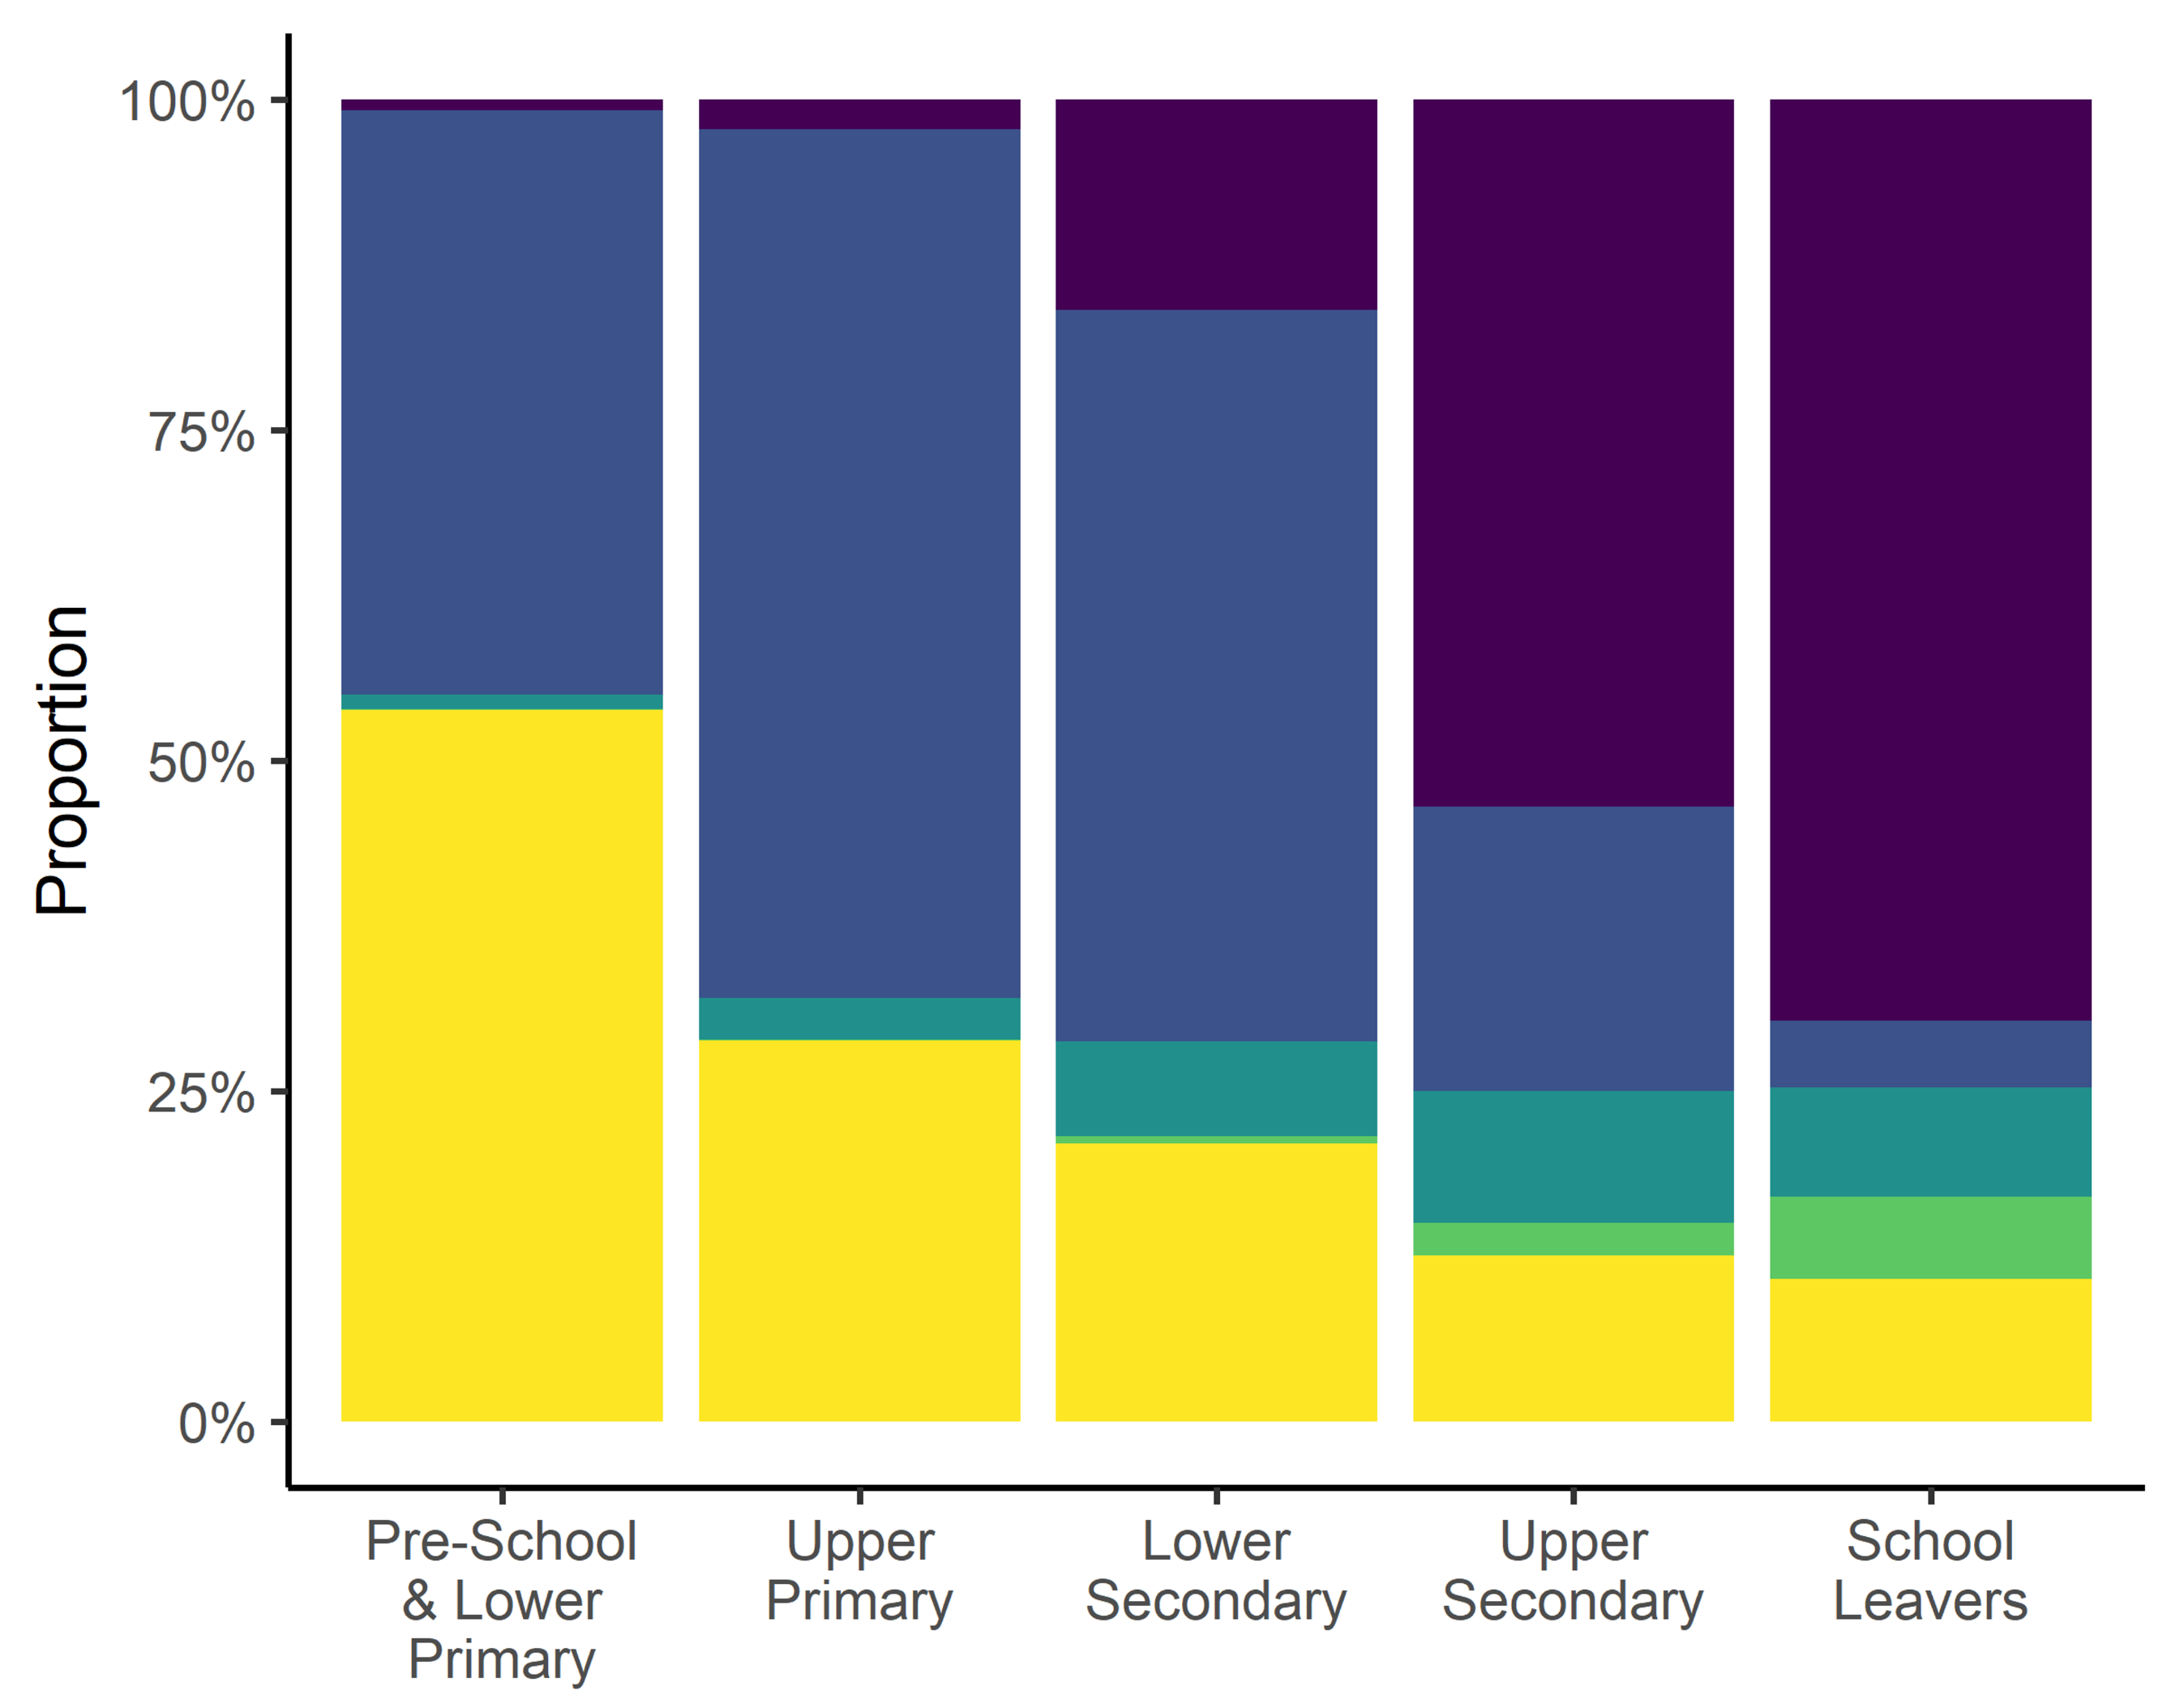
Patterns by Age Group

Slide 8
Patterns by Age Group

Slide 9
Patterns by Sex
Sex | Prescriptions | %
Female | 276,071 | 48
Male | 303,335 | 52
Total | 579,406 | 100
Sex | Individuals | %
Female | 21,388 | 58
Male | 15,763 | 42
Total | 37,151 | 100

Slide 10
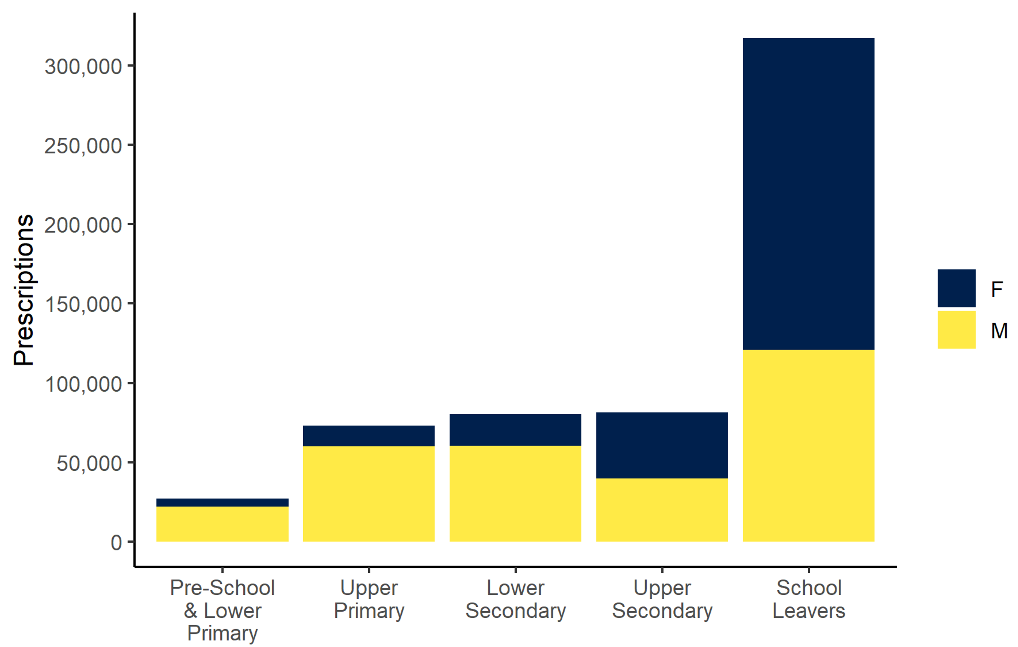
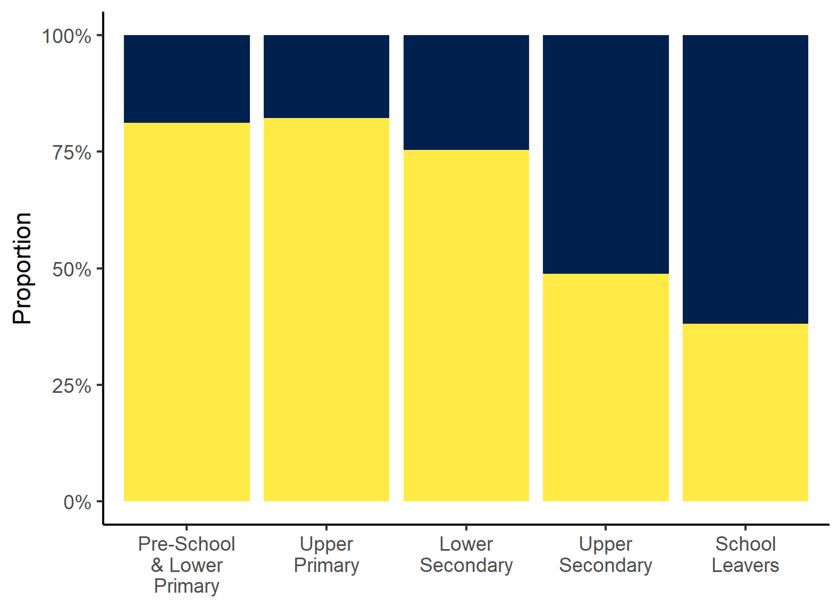
Patterns by Sex

Slide 11
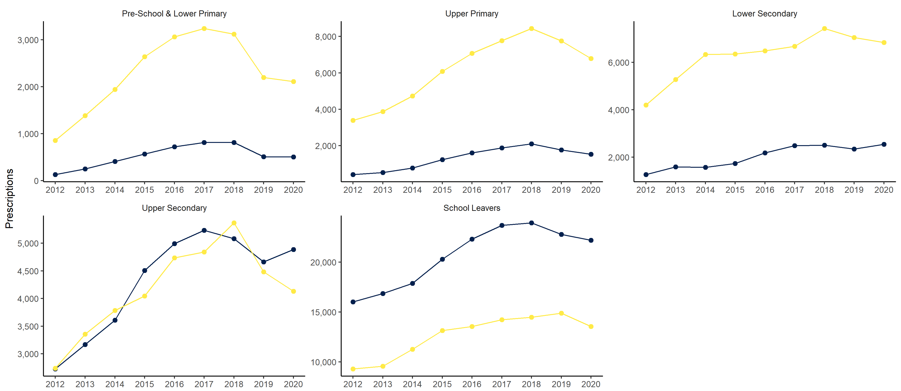
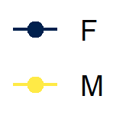
Patterns by Sex

Slide 12
Patterns by Sex

Slide 13
Top Medications – Number of Prescriptions
1. Methylphenidate Hydrochloride 112,951
2. Sertraline 89,230
3. Fluoxetine 64,570
4. Melatonin 61,719
5. Citalopram 49,035

Slide 14
Top Medications – Number of Prescriptions
1. Methylphenidate Hydrochloride 112,951
2. Sertraline 89,230
3. Fluoxetine 64,570
4. Melatonin 61,719
5. Citalopram 49,035

Slide 15
Top Medications – Number of Individuals
1. Sertraline 11,605
2. Fluoxetine 10,196
3. Citalopram 7,873
4. Diazepam 5,920
5. Zopiclone 4,860

Slide 16
Top Medications – Number of Individuals
1. Sertraline 11,605
2. Fluoxetine 10,196
3. Citalopram 7,873
4. Diazepam 5,920
5. Zopiclone 4,860

Slide 17
Area Deprivation
For every 100 people (aged 0-24) living in the most deprived areas, there are on average 62 MH prescriptions per year.
For every 100 people (aged 0-24) living in the least deprived areas, there are on average 26 MH prescriptions per year.

Slide 18
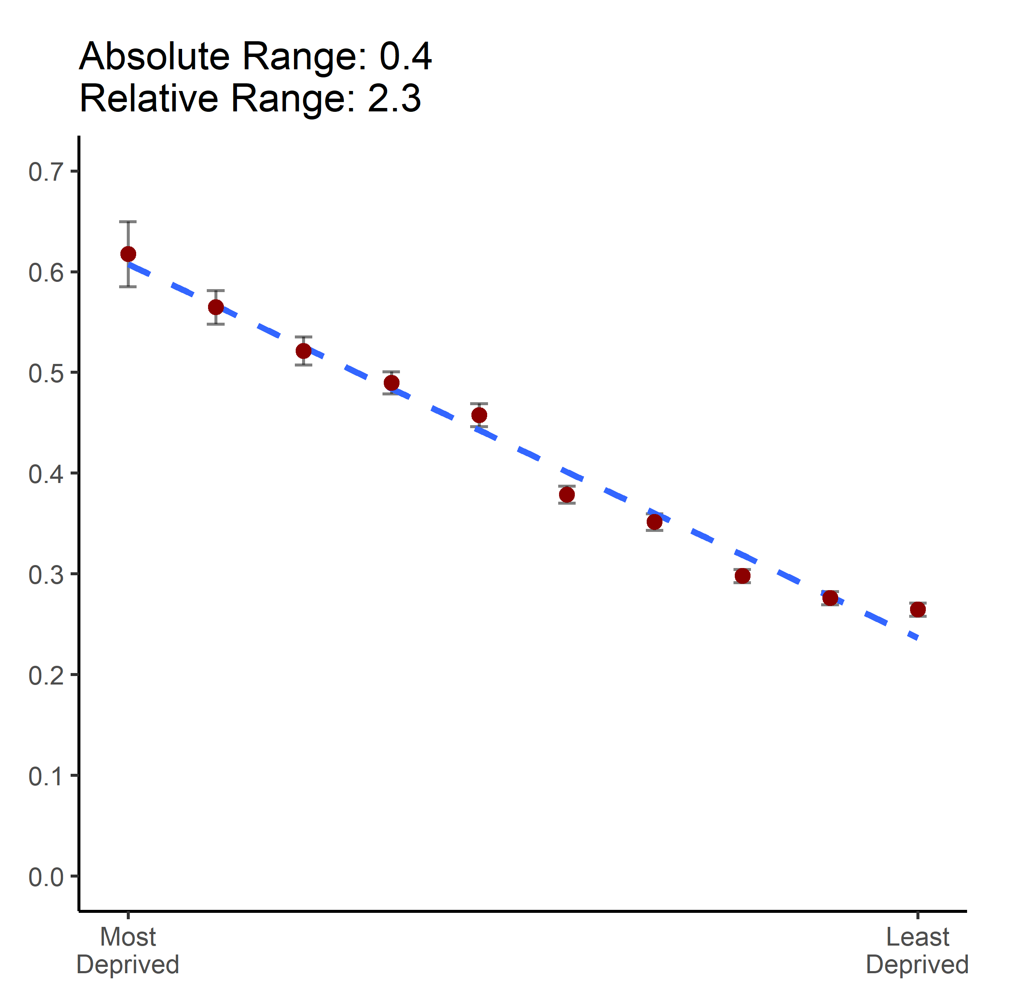
Area Deprivation

Slide 19
Average annual counts & rates of prescriptions by deprivation for 2012-2020
Deprivation Decile | Mean Prescriptions | Mean Individuals | Mean Population | Mean Individual Rate | Mean Individual Rate per 100 | Mean Population Rate | Mean Population Rate per 100
1 - Most | 1,411 | 1,212 | 2,285 | 1.2 | 116.5 | 0.6 | 61.7
2 | 4,410 | 3,725 | 7,809 | 1.2 | 118.4 | 0.6 | 56.5
3 | 5,333 | 4,474 | 10,230 | 1.2 | 119.2 | 0.5 | 52.1
4 | 7,632 | 6,397 | 15,589 | 1.2 | 119.3 | 0.5 | 49.0
5 | 6,077 | 5,103 | 13,284 | 1.2 | 119.1 | 0.5 | 45.7
6 | 7,820 | 6,650 | 20,647 | 1.2 | 117.6 | 0.4 | 37.9
7 | 6,794 | 5,744 | 19,331 | 1.2 | 118.3 | 0.4 | 35.1
8 | 7,886 | 6,693 | 26,464 | 1.2 | 117.8 | 0.3 | 29.8
9 | 6,889 | 5,878 | 24,961 | 1.2 | 117.2 | 0.3 | 27.6
10 - Least | 6,223 | 5,369 | 23,509 | 1.2 | 115.9 | 0.3 | 26.5

Slide 20
Is this useful? What else would you like to see? Contact William.Ball@abdn.ac.uk

